Slide 1

Virtual Machines and Virtualization of Clusters and Data Centers
VIRTUAL CLUSTERS AND RESOURCE MANAGEMENT
Batch 9
Krishna Sagar
Lakshith
Likitha s
N Jhansi mahalakshmi
Suvarnakar Om

Slide 2
CONTENTS
3.4 Virtual cluster and resource management
3.4.1 Physical cluster versus virtual cluster
3.4.2 Live VM Migration:
Steps and Performance Effects
3.4.3 Migration of Memory, Files, and
Network Resources
3.4.4 Dynamic deployment of virtual cluster

Slide 3


3.4.1 Physical cluster versus virtual cluster
A physical cluster is a collection of servers (physical machines) interconnected by a physical network such as a LAN.
Virtual clusters consist of VMs running on multiple distributed servers from one or more physical clusters. These VMs communicate with each other through a virtual network that operates over multiple physical networks.
Traditional VM setups need manual configuration, causing inefficiencies.
More VMs can lead to resource overloading or underutilization due to improper configurations.
Amazon EC2 offers elastic computing power for easy VM creation and management.
Virtualization platforms like XenServer and VMware ESX Server support bridging mode, allowing VMs to act as separate networked devices.
Bridging mode facilitates free communication and and helps VMs automatically set up their network settings

Slide 4

three critical design issues of virtual clusters:
•live migration of VMs-moving a VM from one physical server to another without shutting it down
•memory and file migrations-transferring the memory and files of a VM when it moves to a different server
•dynamic deployment of virtual clusters-allows VMs to be added or removed from a cluster based on current needs.
Virtual machines (VMs) are dynamically assigned to a virtual cluster with key features:
Nodes can be physical or virtual, running multiple operating systems on one server.
Each VM uses a guest OS different from the host OS managing resources.
VMs enhance resource usage and application flexibility by combining functions on a single server.
VMs can be replicated across servers for improved distributed parallelism, fault tolerance, and disaster recovery.
The virtual cluster size can adjust dynamically, like a P2P network.
A physical node failure stops its VMs, but VM failures do not impact the host system.

Slide 5
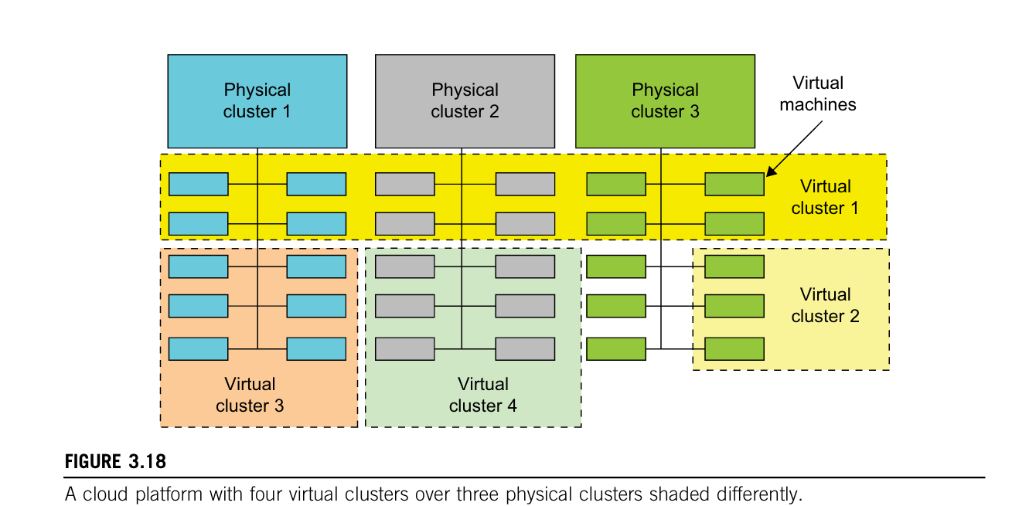

Slide 6
System virtualization requires efficient management of VMs across multiple physical nodes (virtual clusters) to create a high-performance computing environment. This includes:
Deployment & Management: Virtual clusters need proper setup, monitoring, and resource management.
Optimization Techniques: Load balancing, server consolidation, and fault tolerance help improve efficiency.
VM Image Storage: Storing VM images efficiently is crucial due to their large numbers.
Template VMs: Preinstalled templates (OS and libraries) allow users to quickly build customized software stacks.
Host & Guest Systems: Physical machines (hosts) run VMs (guests), which may have different operating systems.
Each VM can be deployed on a remote server or duplicated across multiple servers within the same or different physical clusters. The structure of a virtual cluster is flexible, allowing VM nodes to be added, removed, or moved dynamically.

Slide 7
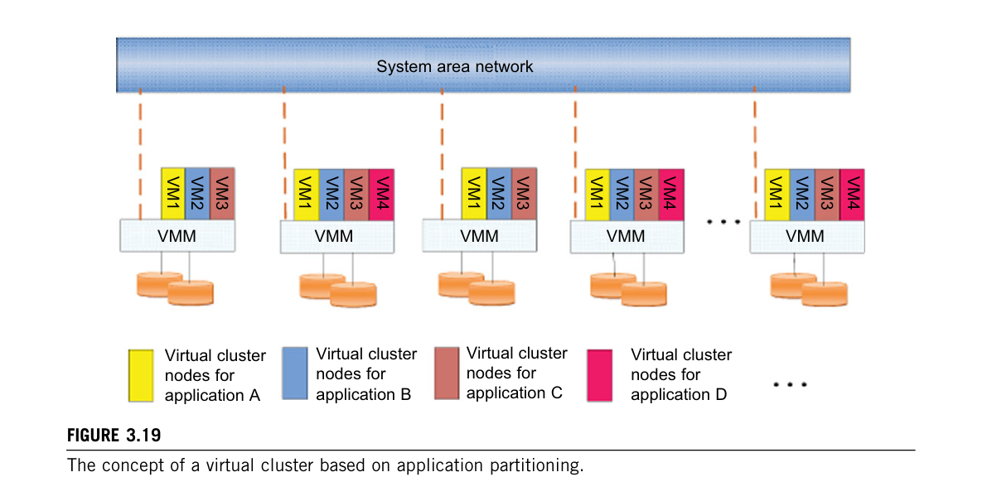

Slide 8
FAST DEPLOYMENT AND EFFECTIVE SCHEDULING
Fast Deployment: The system should quickly set up software stacks (OS, libraries, applications) on physical nodes and efficiently switch between virtual clusters for different users.
Resource Optimization: When a user is done, their virtual cluster should shut down or suspend to free resources for others.
Green Computing: Traditional energy-saving methods focus on single machines, but virtual clusters need global energy efficiency strategies.
Live Migration: Workloads can be transferred between nodes, but excessive migration can negatively impact performance.
Load Balancing: Based on user logins and system load, VMs should be mapped to the best physical nodes and dynamically adjusted to optimize resource use and response time.

Slide 9

High-Performance Virtual Storage
Template VMs: Preinstalled software templates speed up VM customization and switching between environments.
Efficient Storage Management : Disk space is optimized by reducing duplicate data blocks.
Hash values help identify and manage data blocks.
User profiles store unique data block identifications.
VM Deployment Steps:
Prepare the disk image (using templates for efficiency).
Configure the VM (name, network, CPU, memory).
Choose a destination node (ensuring load balancing).
Execute deployment on each host.
Copy-on-Write (COW) Format:Saves disk space and shortens deployment time by creating small, efficient backups instead of copying entire disk images.
Preedited Profiles: Easily set up multiple VMs using default settings while automatically giving each a unique ID, name, and IP.
Host Selection Strategy : Balances workloads and optimally assigns VMs without user concern for the specific host.

Slide 10
Live VM Migration: Steps and Performance Effects
1. Overview of Live VM Migration
- Process of moving a running Virtual Machine (VM) from one host to another.
- Ensures minimal downtime and service disruption.
- Common in cloud computing, HPC, and virtual clusters.
2. Importance of Live Migration
- Enables dynamic resource allocation.
- Supports load balancing and server consolidation.
- Facilitates disaster recovery and failover.
3. Virtual Cluster Management Approaches
- Guest-based manager: Cluster manager runs inside guest OS (e.g., openMosix).
- Host-based manager: Cluster manager runs on host system (e.g., VMware HA).
- Independent cluster manager: Manages both host and guest, increasing complexity.
- Integrated cluster manager: Distinguishes between virtual and physical resources.

Slide 11
4. Six Steps of Live VM Migration
- Step 0 & 1: Migration starts; prepares VM and selects target host.
- Step 2: Memory transfer begins with iterative pre-copying.
- Step 3: VM suspends; final memory and CPU/network states copied.
- Step 4 & 5: VM activated on target host; network connections redirected.
5. Performance Effects of Migration
- Downtime: Minimal service unavailability (e.g., 165ms in experiments).
- Throughput Impact: Gradual reduction in data transfer rate during migration.
- Overhead Considerations: Optimizing for minimal CPU, memory, and bandwidth use.
6. Application in Cloud Computing
- Key for elastic resource provisioning.
- Enables seamless failover and scaling.
- Critical for uninterrupted cloud services.

Slide 12
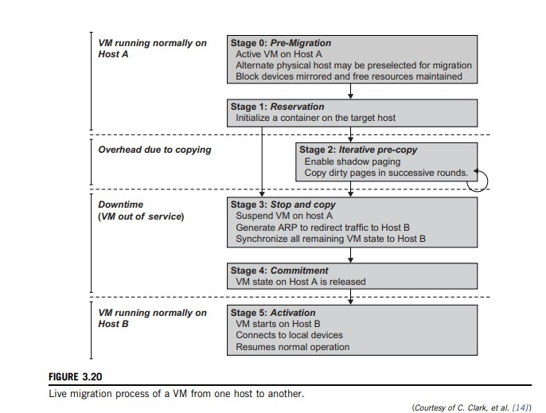

Slide 13
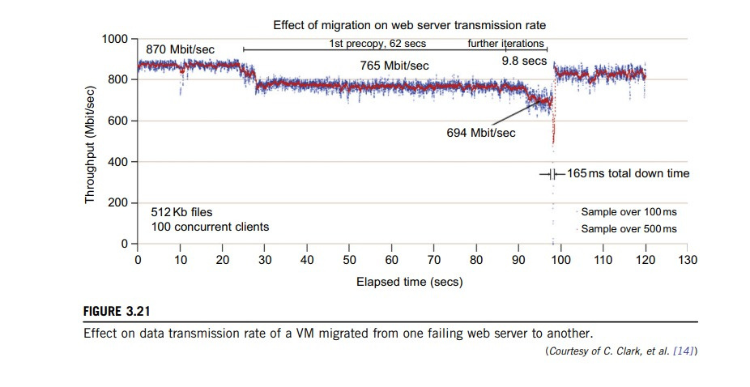

Slide 14
Migration of Memory, Files, and Network Resources
This is one of the most important aspects of VM migration. Moving the memory instance of a VM from one physical host to another can be approached in any number of ways.
But traditionally, the concepts behind the techniques tend to share common implementation paradigms.
The techniques employed for this purpose depend upon the characteristics of application/ workloads supported by the guest OS.
Memory migration can be in a range of hundreds of megabytes to a few gigabytes in a typical system today, and it needs to be done in an efficient manner.
Memory Migration:

Slide 15
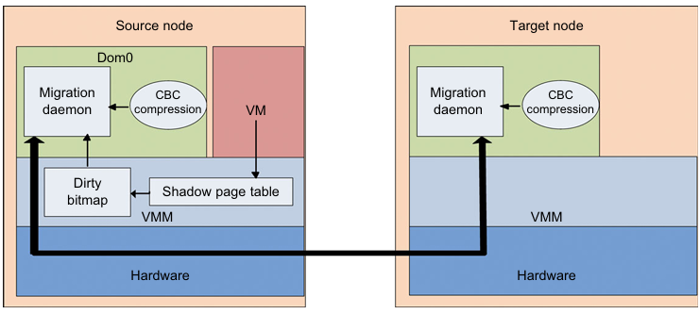
Live migration of VM from the Dom0 domain to a Xen-enabled target host.

Slide 16
File System Migration:
To support VM migration, a system must provide each VM with a consistent, location-independent view of the file system that is available on all hosts.
A simple way to achieve this is to provide each VM with its own virtual disk which the file system is mapped to and transport the contents of this virtual disk along with the other states of the VM.
However, due to the current trend of high capacity disks, migration of the contents of an entire disk over a network is not a viable solution.
Another way is to have a global file system across all machines where a VM could be located. This way removes the need to copy files from one machine to another because all files are network accessible.

Slide 17
Network Migration:
A migrating VM should maintain all open network connections without relying on forwarding mechanisms on the original host or on support from mobility or redirection mechanisms.
To enable remote systems to locate and communicate with a VM, each VM must be assigned a virtual IP address known to other entities.
This address can be distinct from the IP address of the host machine where the VM is currently located.
Each VM can also have its own distinct virtual MAC address. The VMM maintains a mapping of the virtual IP and MAC addresses to their corresponding VMs.
In general, a migrating VM includes all the protocol states and carries its IP address with it.

Slide 18
Live Migration of VMs between Two Xen-Enabled Hosts:
Xen supports live migration. It is a useful feature and natural extension to virtualization platforms that allows for the transfer of a VM from one physical machine to another with little or no downtime of the services hosted by the VM.
Live migration transfers the working state and memory of a VM across a net work when it is running.
Xen also supports VM migration by using a mechanism called Remote Direct Memory Access (RDMA).

Slide 19
Dynamic Deployment of Virtual Clusters:
"Dynamic Deployment of Virtual Clusters" refers to the process of creating, managing, and scaling virtual clusters on demand, often in cloud or virtualized environments.
This approach is commonly used in cloud computing, high-performance computing (HPC), and container orchestration.
Virtual Clusters Concept: Enables dynamic allocation of computing resources from a shared physical infrastructure.

Slide 20
COD (Cluster-on-Demand): Developed at Duke University, allowing users to create and manage virtual clusters dynamically.
VIOLIN Project: Developed at Purdue University, focusing on adaptive virtual environments with VM migration capabilities.
Resource Management: Supports policy-based sharing, resource reservation, and adaptive provisioning.
Workload Scaling: Virtual clusters can dynamically expand or shrink based on real-time workload demands.

Slide 21
Experimentation: COD was tested on 80 IBM xSeries-335 servers, showing significant flexibility in resource utilization.
Efficiency & Performance: Virtualization improves resource utilization while maintaining low adaptation overhead (less than 1%).
Virtual Networking: A crucial component for seamless integration and communication between virtualized environments.
Grid & Cloud Computing Impact: These technologies contribute to efficient computing utilities, enabling scalable and cost-effective solutions.

Slide 22

MULTIPLE CHOICE QUESTIONS
(MCQ’s)

Slide 23
1. What is one of the key advantages of using Template VMs in virtual clusters?*
A) They increase the physical storage requirement for each VM
B) They allow quick setup of customized software stacks with preinstalled OS and libraries
C) They prevent live migration of VMs between physical nodes
D) They restrict VMs to using only one operating system

Slide 24
*Answer:*
B) They allow quick setup of customized software stacks with
preinstalled OS and libraries

Slide 25
*2. How does the Copy-on-Write (COW) format help in VM deployment?*
A) It reduces disk space usage by creating small, efficient backups instead of copying entire disk images
B) It prevents virtual clusters from resizing dynamically
C) It forces users to manually configure each new VM from scratch
D) It increases deployment time by making full copies of disk images

Slide 26
*Answer:*
A) It reduces disk space usage by creating small, efficient
backups instead of copying entire disk images

Slide 27
*3. What is a major consideration when using live migration in virtual clusters?*
A) It always improves system performance without any drawbacks
B) Excessive migration can negatively impact system performance
C) It does not require any network configuration adjustments
D) Physical node failures do not affect live migration

Slide 28
*Answer:*
B) Excessive migration can negatively impact system performance

Slide 29
*4. What is the main challenge of memory migration in VM migration?*
A) Ensuring the physical host has enough CPU power
B) Efficiently moving memory, which can range from hundreds of MBs to a few GBs
C) Changing the VM's operating system during migration
D) Restarting the VM after migration

Slide 30
*Answer:*
B) Efficiently moving memory, which can range from
hundreds of MBs to a few GBs

Slide 31
*5. Why is migrating an entire virtual disk over a network not a viable solution?*
A) It requires too much CPU processing power
B) It results in data loss during transfer
C) High-capacity disks make it inefficient to transfer all contents over a network
D) Virtual disks cannot be copied over a network

Slide 32
*Answer:*
C) High-capacity disks make it inefficient to transfer
all contents over a network

Slide 33
*6. How does a migrating VM maintain network connectivity?*
A) By using the IP address of the host machine
B) By relying on network forwarding mechanisms on the original host
C) By resetting all network connections after migration
D) By carrying its IP and MAC address with it and maintaining protocol states

Slide 34
*Answer:*
D) By carrying its IP and MAC address with it and
maintaining protocol states

Slide 35
*7. What is the primary goal of live VM migration?*
A) Moving a running VM to another host with minimal downtime
B) Permanently shutting down a VM for maintenance
C) Increasing the physical hardware requirements for a VM
D) Duplicating VMs across multiple hosts for backup

Slide 36
*Answer:*
A) Moving a running VM to another host with minimal downtime

Slide 37
*8. Which step in live VM migration involves suspending the VM and copying
final memory and CPU states?*
A) Step 0
B) Step 1
C) Step 5
D) Step 3

Slide 38
*Answer:*
D) Step 3

Slide 39
*9. What is the primary benefit of Virtual Clusters?*
A) Fixed allocation of resources
B) Dynamic allocation of computing resources from a shared physical
infrastructure
C) Eliminating virtualization overhead
D) Reducing the need for networking

Slide 40
*Answer:*
B) Dynamic allocation of computing resources from a shared
physical infrastructure

Slide 41

*10. What was the outcome of testing COD on 80 IBM xSeries-335 servers?*
A) Increased virtualization overhead
B) Limited resource utilization
C) Reduced computing efficiency
D) Improved flexibility in resource management

Slide 42
*Answer:*
D) Improved flexibility in resource management

